Slide 1


Slide 2

Group Members
07. Parth Zarekar
10. Krishnaraj Thadesar
24. Singh Soubhagya
25. Sourab Karad

Slide 4
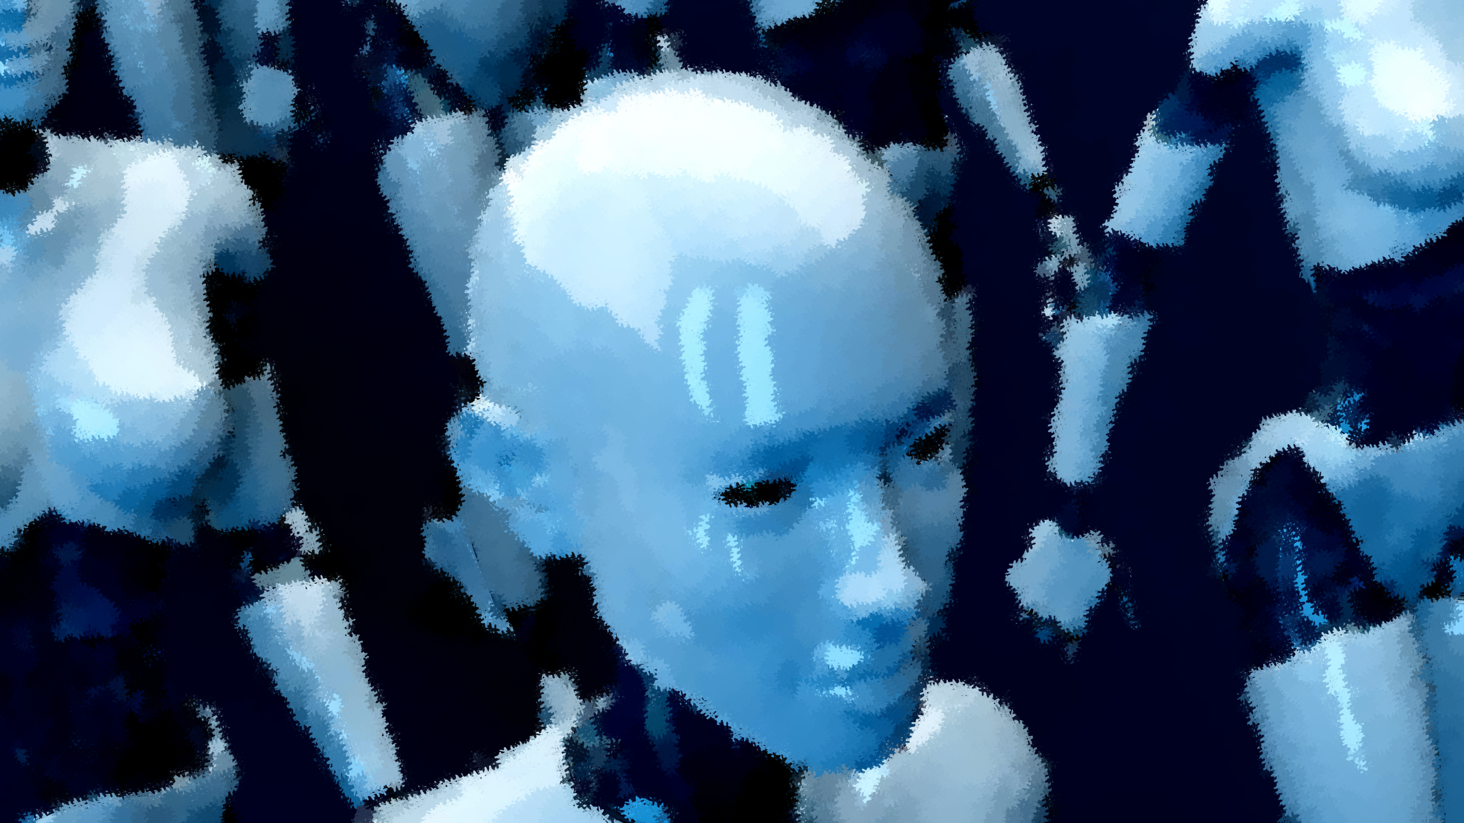
Neural Networks
Method in artificial Intelligence that teaches computers to process data in a way that is inspired by human brain.

Slide 5
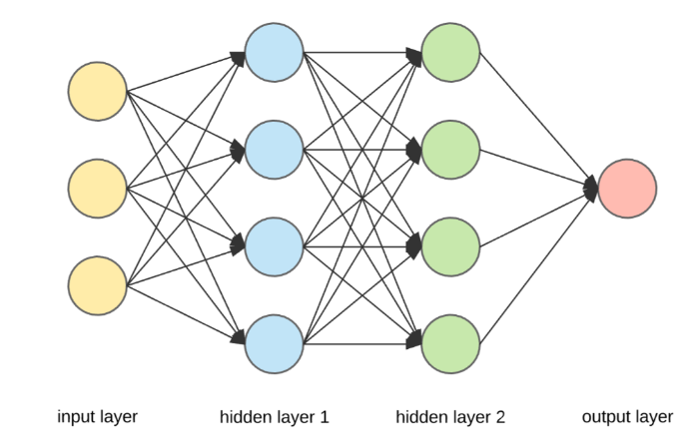
Components of Neural Network
Input Layer
Imagine this as eyes and ears of the network.
Hidden Layers
Hidden layers are where most of the thinking happens
Output Layer
The output Layer produces the final results of the networks calculations

Slide 6
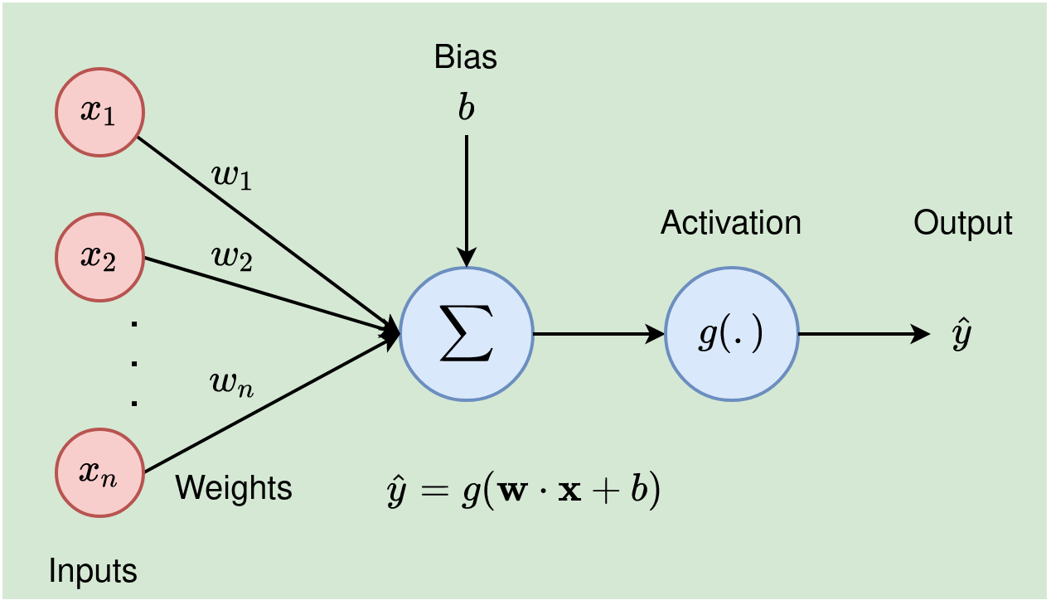
Neurons (Nodes)
Neurons information from input layer or other neuron and make calculations.
Weights
Neurons assign importance to the information they receive through weights
Bias
Biases act like a starting point for each neuron's calculation.

Slide 7
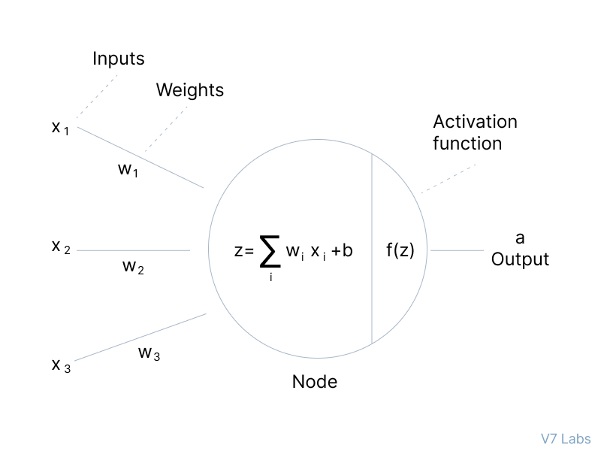
Decides when a neuron should "fire" or activate.
Activation Function

Slide 8
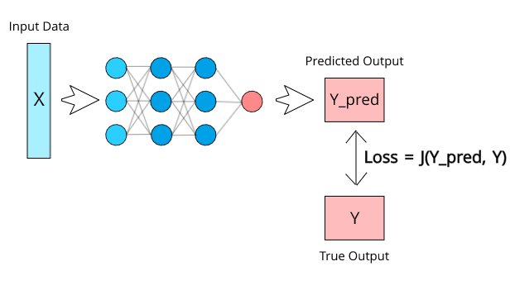
Loss Function
It calculates how far networks calculated output is from actual desired output.

Slide 9

Optimizers
Helps neural network to adjust its weights and biases to reduce the loss

Slide 10
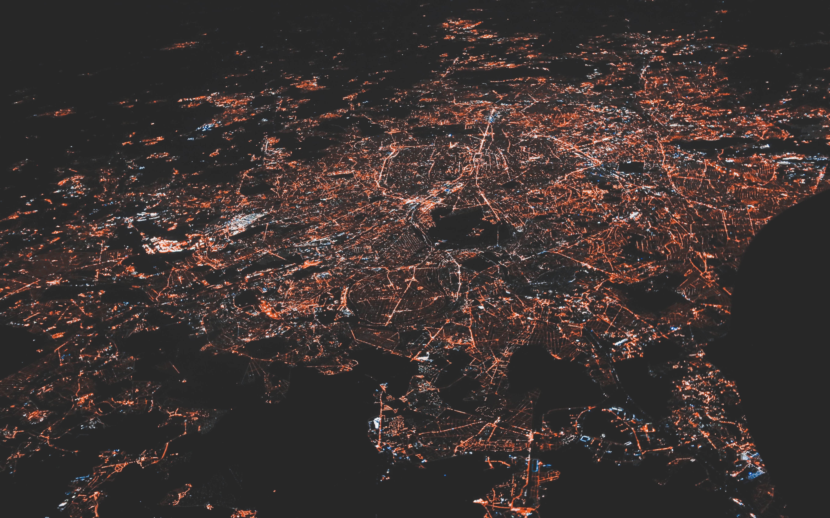
Back Propagation
It tells network how it should adjust its internal settings to perform better in future

Slide 12
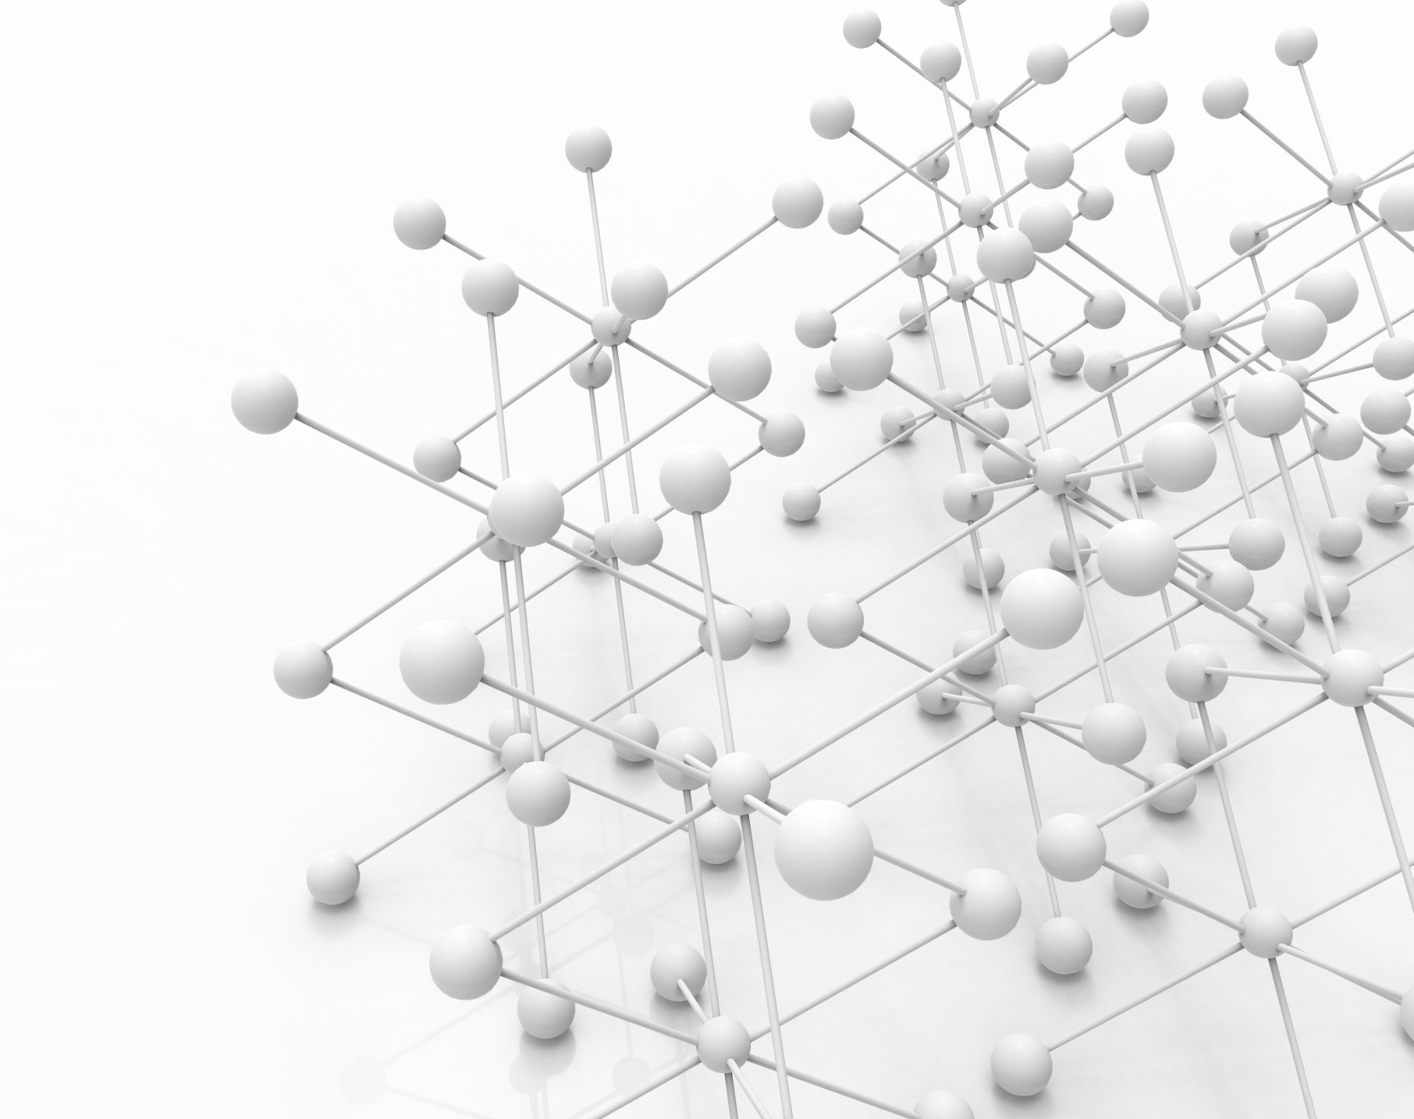
What is a Perceptron
A perceptron is a fundamental building block in artificial neural networks and serves as a simple model of a biological neuron. It's a binary linear classifier that can be used for various machine learning tasks, such as binary classification.

Slide 13
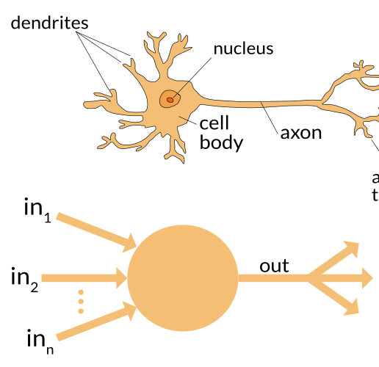
Comparison to a Neuron
It is a basic unit of an artificial neural network that takes a set of input values, processes them, and produces an output.

Slide 14
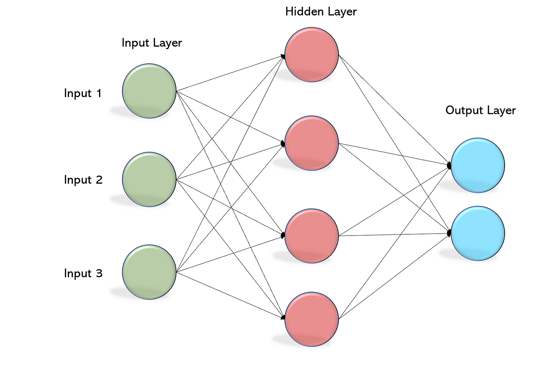
Multilayer Perceptron
Multilayer Perceptrons (MLPs), also known as feedforward neural networks or artificial neural networks, are a type of artificial neural network with multiple layers of interconnected neurons.
These networks consist of an input layer, one or more hidden layers, and an output layer. Multilayer Perceptrons are designed to handle more complex tasks than single-layer perceptrons, as they can capture non-linear patterns in data.

Slide 15
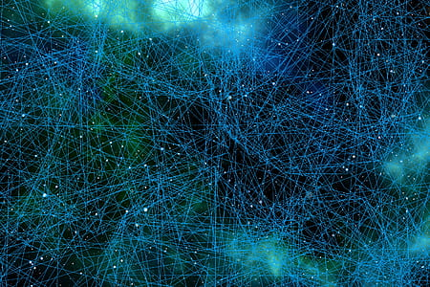
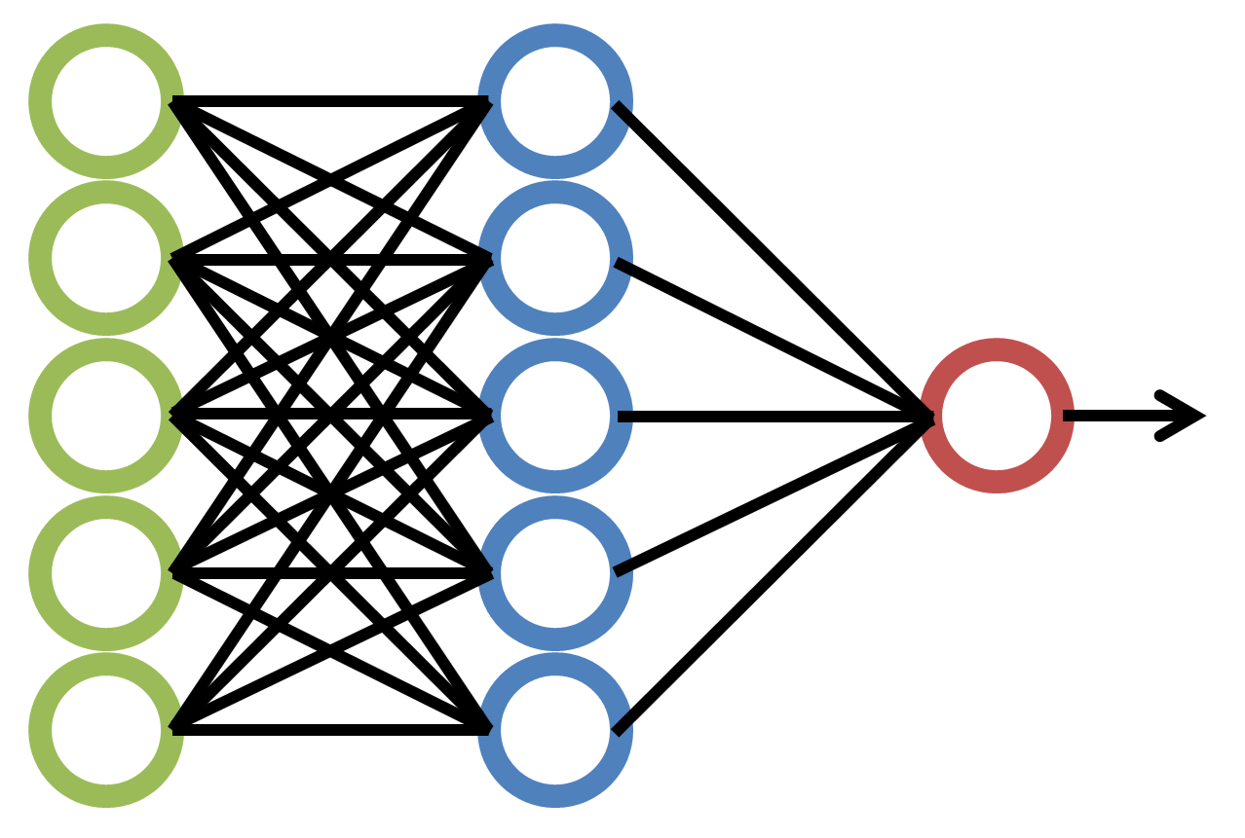

Back Propagation: Unveiling the Inner Workings of Neural Networks
24. Saubhagya Singh

Slide 16
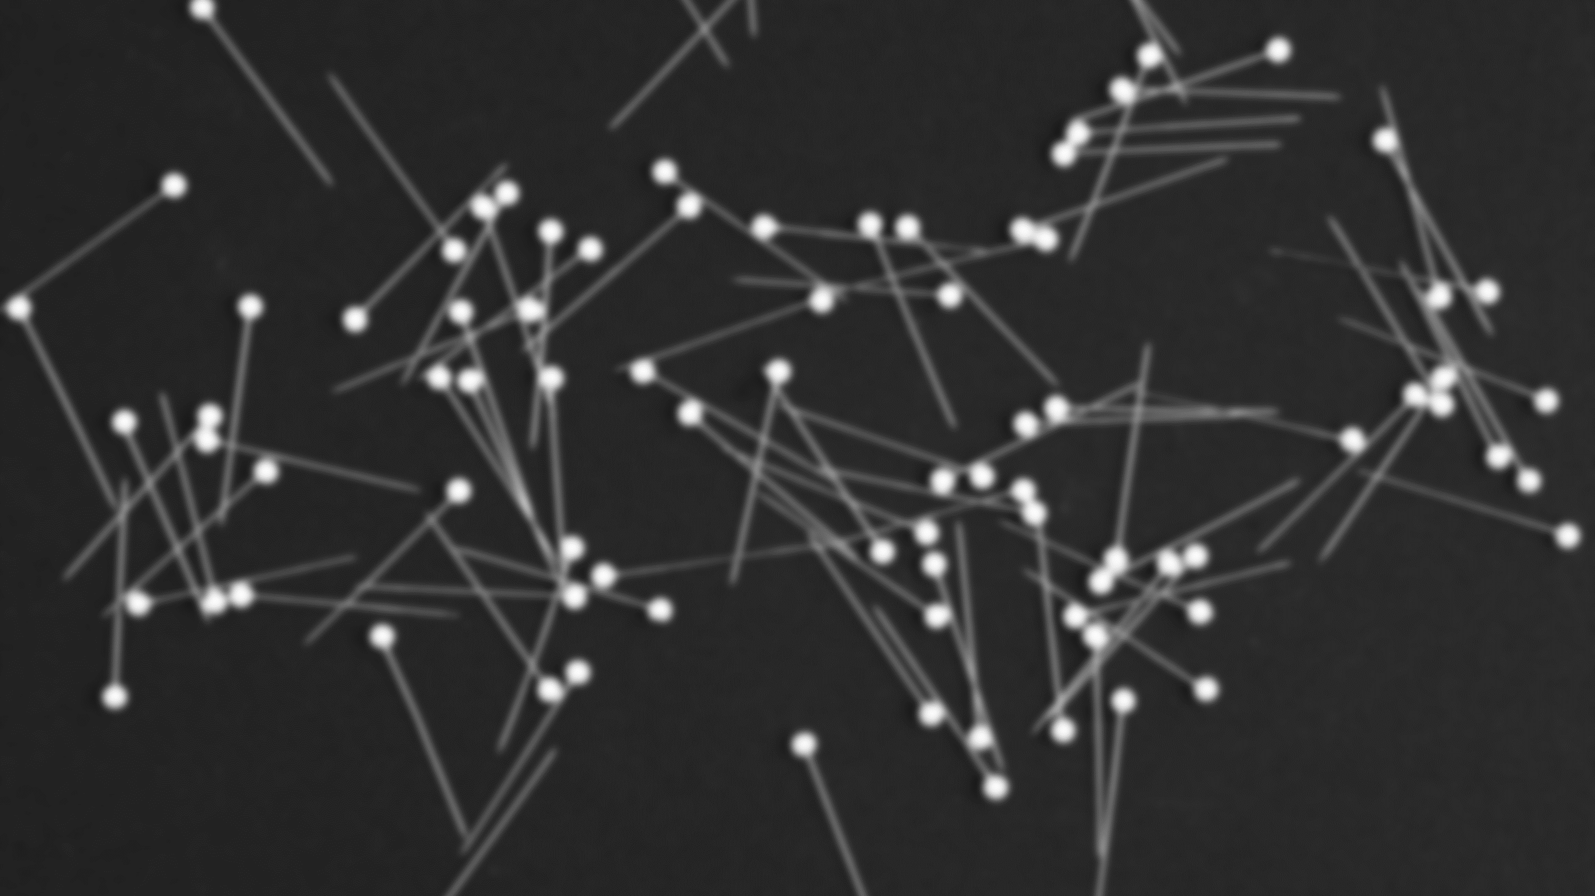
Understanding Back Propagation
Back propagation is a key algorithm for training neural networks. It enables the network to learn from labeled training data and adjust its internal parameters to minimize the error between predicted and actual outputs.
The algorithm works by propagating the error backwards through the network, updating the weights and biases of each neuron based on their contribution to the overall error. This iterative process continues until the network achieves satisfactory performance.

Slide 17
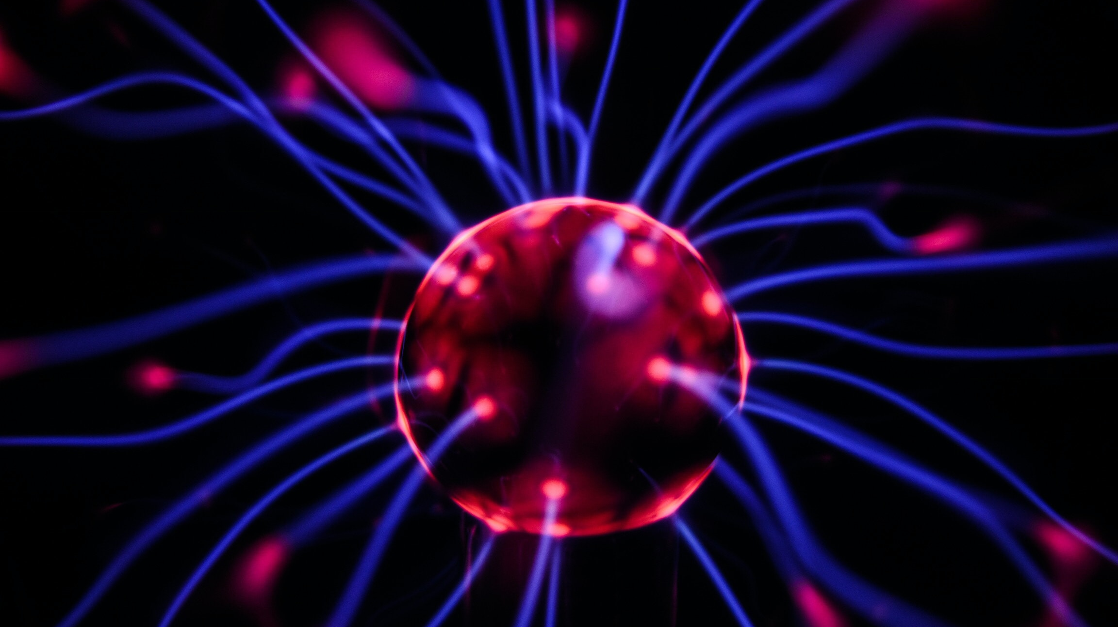
Working of Back Propagation

Slide 18
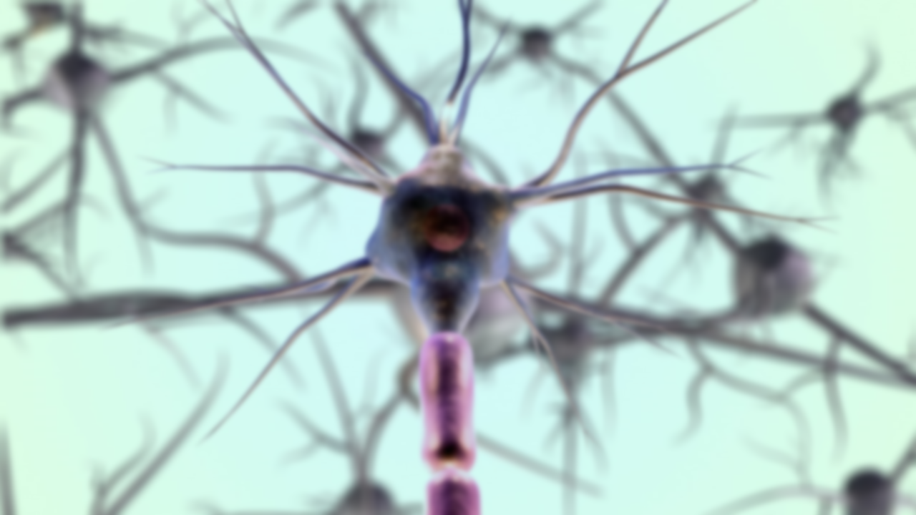
Definition of Backpropagation
Backpropagation is a crucial algorithm in artificial neural networks, especially in training deep learning models.
Purpose of Backpropagation
It optimizes neural network weights to minimize the error between predictions and actual target values.
Forward Pass
Input data traverse the network, passing through neurons for weighted summations and activation functions.
Loss Computation
The algorithm quantifies the difference between predictions and ground truth through loss calculation.

Slide 19
Error Propagation
Backpropagation propagates error from output to input layer, computing gradients of loss with respect to each neuron's weights.
Guidance for Weight Adjustments
These gradients serve as guidance for adjusting neuron weights to minimize the loss function.
Gradient Descent Optimization
Weight adjustments are made using gradient descent algorithms to iteratively minimize the loss.
Iterative Process
This process continues until the model's predictions closely align with the target values, enabling accurate predictions.

Slide 20

Importance of Back Propagation
1. Neural Network Training: Backpropagation is the primary technique for training neural networks, enabling them to make accurate predictions and solve complex tasks.
2. Universal Function Approximation: It allows neural networks to approximate a wide range of complex functions, making them versatile tools for various applications.
3. Feature Learning: Neural networks using backpropagation automatically learn and extract relevant features from raw data, reducing the need for manual feature engineering.

Slide 21

4. Generalization: Backpropagation helps neural networks generalize from training data to make accurate predictions on unseen data, a fundamental aspect of machine learning models.
5. State-of-the-Art Performance: Deep learning models trained with backpropagation have achieved state-of-the-art results in diverse domains, driving research and innovation in machine learning.

Slide 23

Architecture of Backpropagation
Forward Pass: Input data is passed forward through the neural network layers to generate a prediction.
Backward Pass: Error calculation is performed by comparing the predicted output to the actual output, and this error is propagated backward through the network to adjust weights using the gradient descent algorithm

Slide 24

Gradient Descent
Optimization technique used in backpropagation to minimize the error by adjusting weights. It calculates the gradient of the cost function with respect to each weight.
Activation Functions
Functions used at each neuron to introduce non-linearity. Common activation functions include ReLU, sigmoid, and tanh.
Backpropagation Key Components
Error calculation, chain rule application, weight updates using calculated gradients, learning rate adjustment.

Slide 26
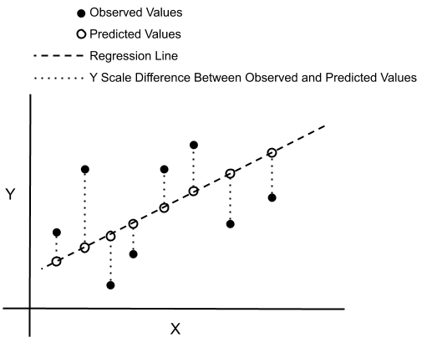
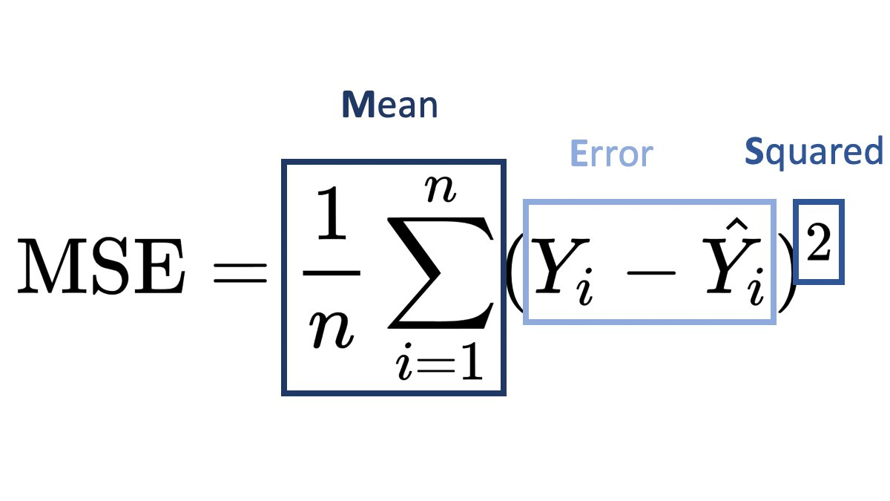
Cost Functions
Mean Squared Error (MSE): Measures the average of the squared differences between predictions and actual values.
Cross-Entropy Loss: Commonly used in classification problems. It measures the performance of a classification model whose output is a probability value between 0 and 1

Slide 27

Role of Cost Functions:
Cost functions help quantify the error between predicted and actual values. The goal is to minimize this error during training by adjusting network weights.

Slide 28
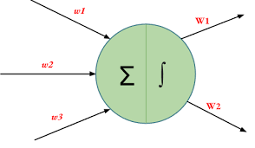
Weight Initialization
Random Initialization: Weights are initialized randomly to break symmetry among neurons.
Random Normal: The weights are initialized from values in a normal distribution.
Random Uniform: The weights are initialized from values in a uniform distribution.

Slide 29
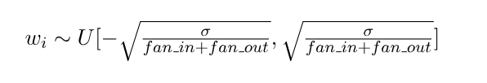
Xavier Glorot Initialization
Sets initial weights based on the number of input and output neurons of the layer.
Xavier/Glorot Initialization often termed as Xavier Uniform Initialization, is suitable for layers where the activation function used is Sigmoid.
In Xavier/Glorot weight initialization, the weights are assigned from values of a uniform distribution as follows:

Slide 30
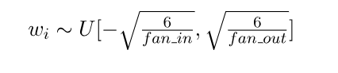
He Initialization
Similar to Xavier, but taking into account the ReLU (rectified linear) activation function.
In the Uniform weight initialization, the weights are assigned from values of a uniform distribution as follo
He Uniform Initialization is suitable for layers where ReLU activation function is used

Slide 31

Importance of Weight Initialization
Proper weight initialization helps in convergence speed, prevents vanishing/exploding gradients, and aids in better training of neural networks.

Slide 33
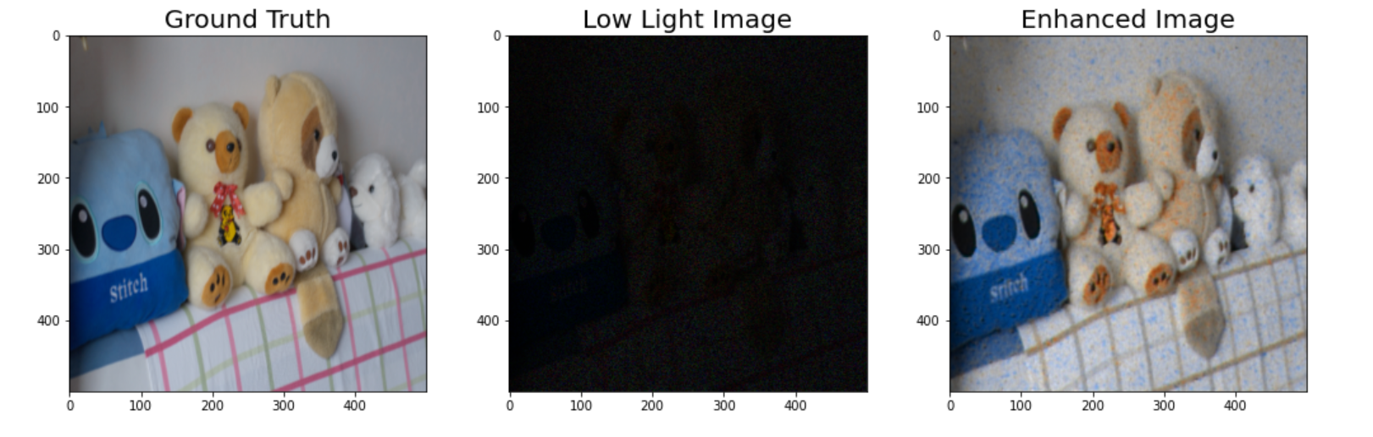

Slide 34
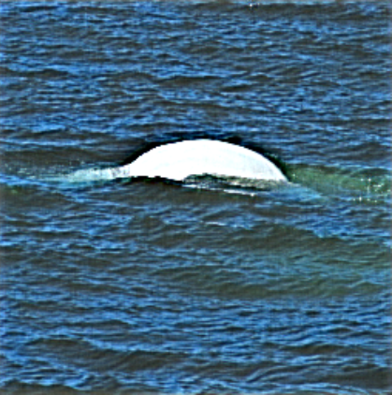
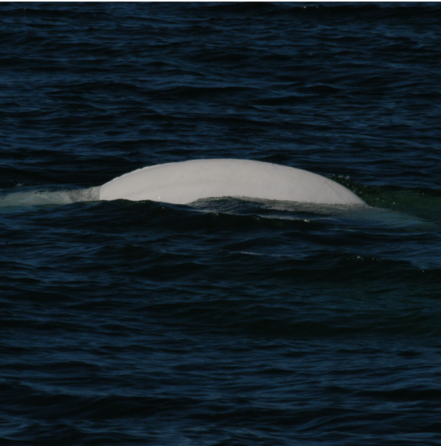

Slide 35
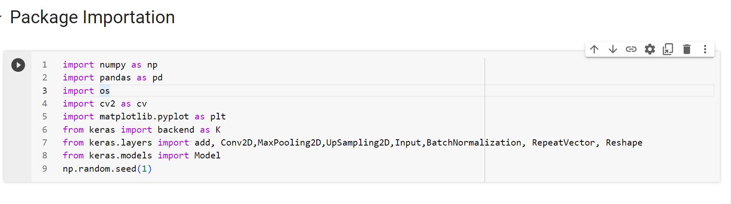
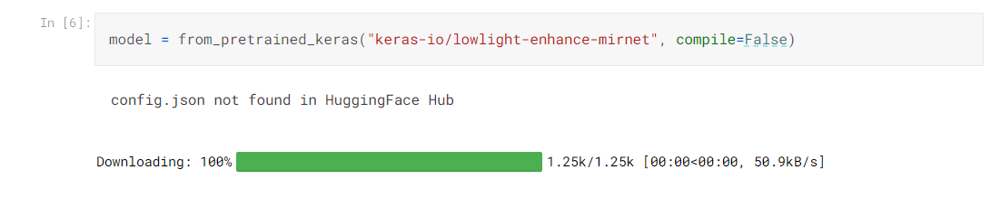

Slide 36
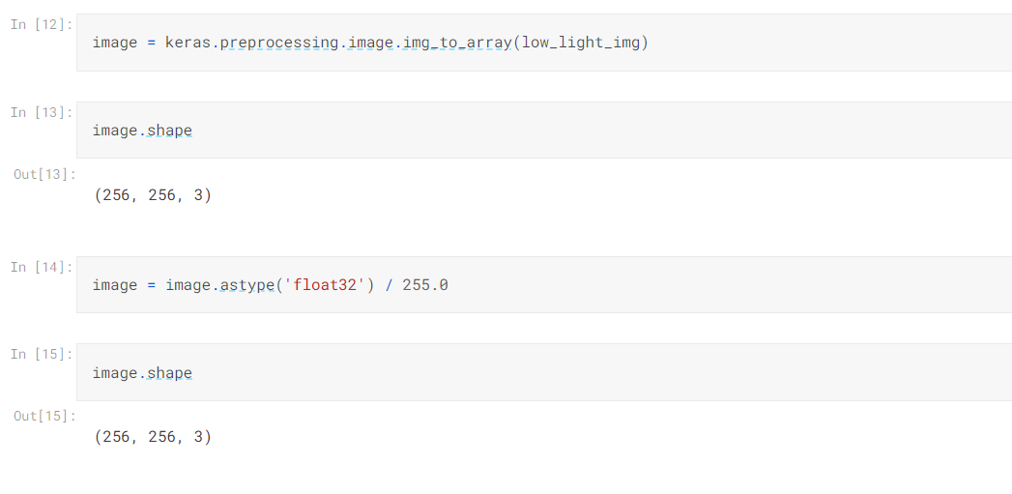

Slide 37
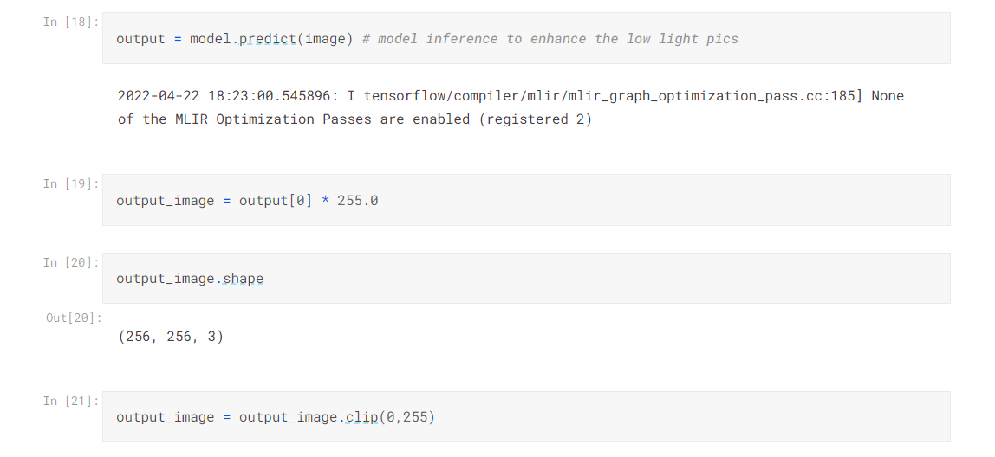

Slide 38
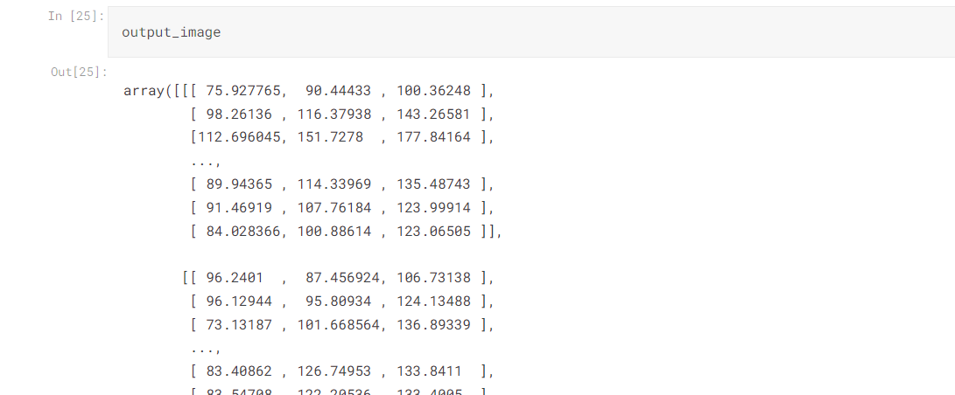

Slide 39
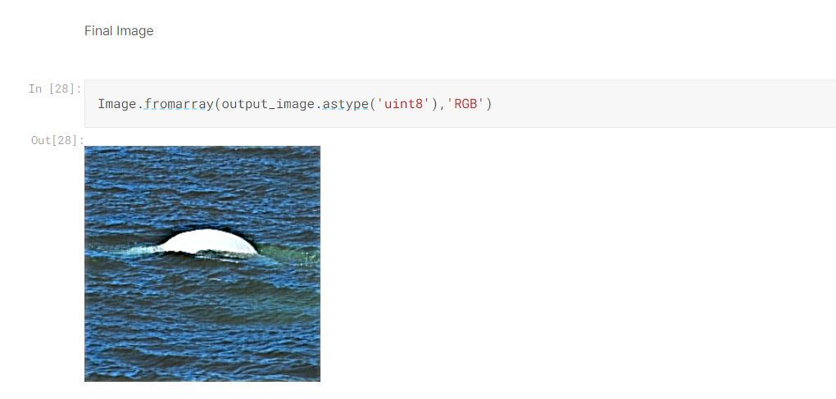

Slide 40
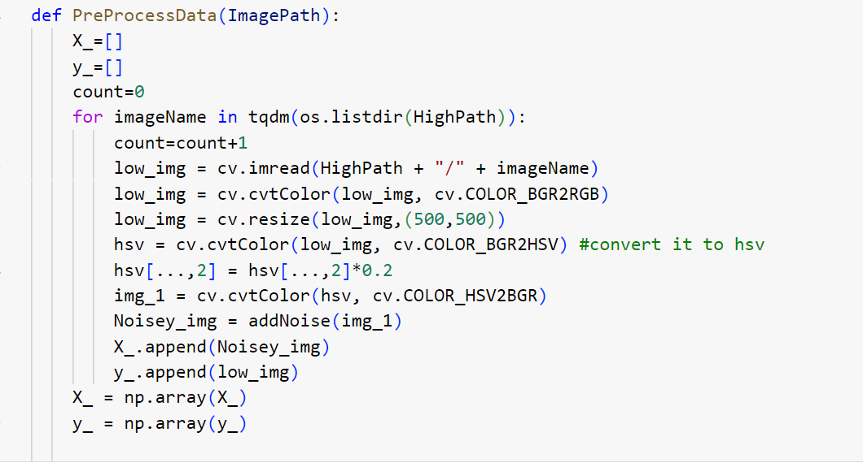

Slide 41
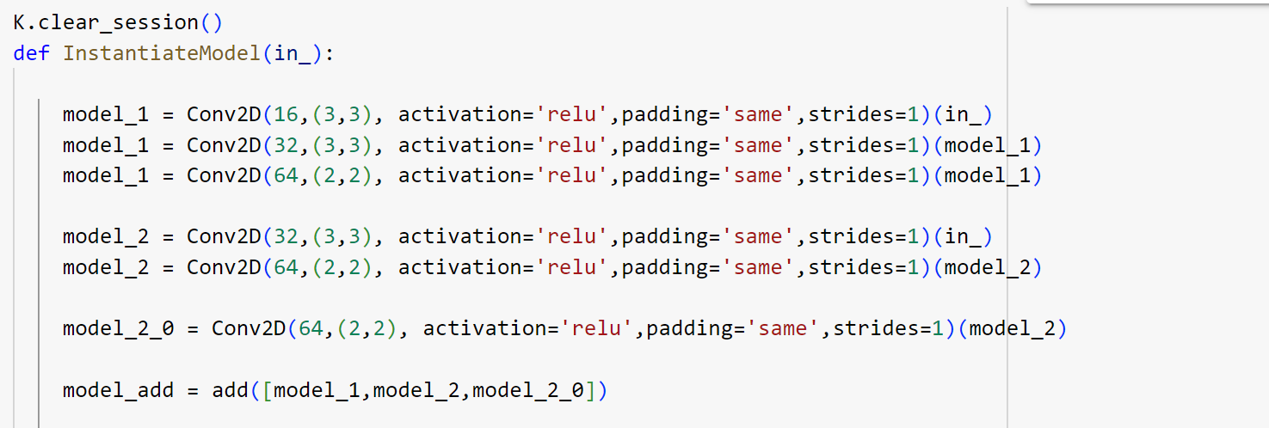
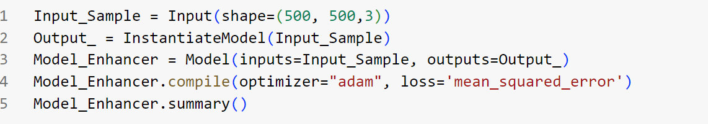

Slide 42
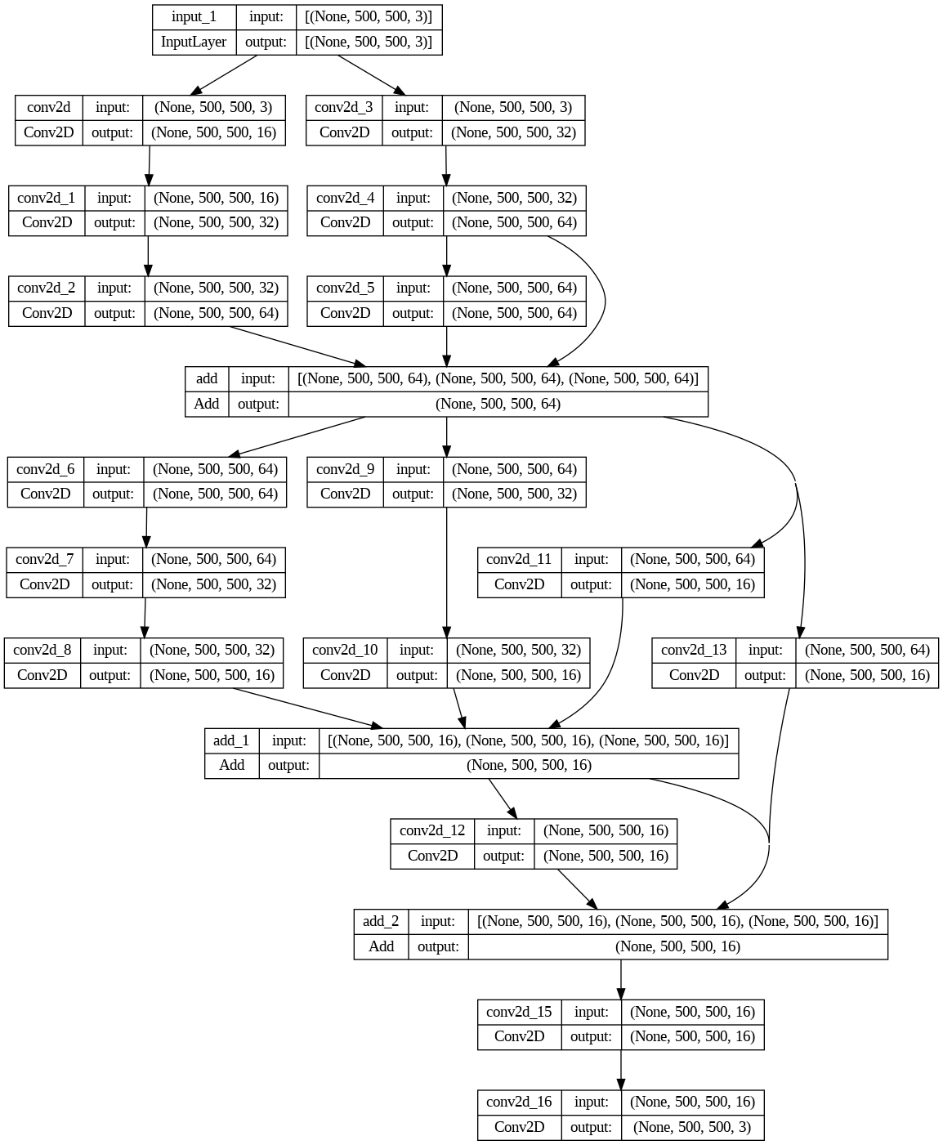

Slide 43
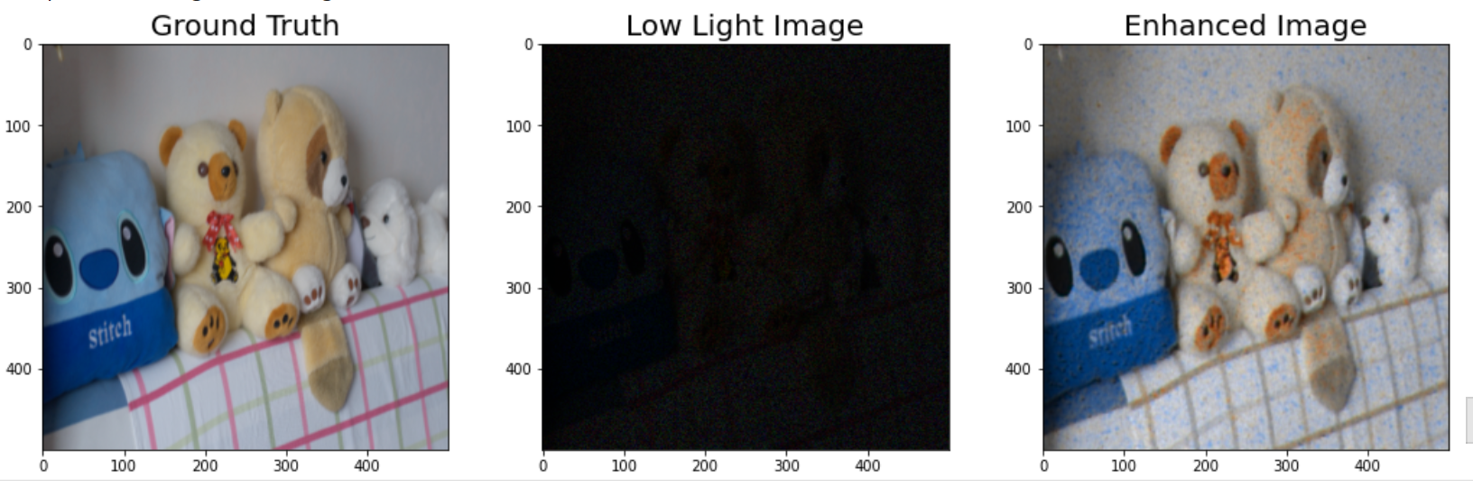

Slide 44

References
Machinelearningmastery.com
https://www.youtube.com/live/GK5ATUhdH74?si=umyaNz3ZY-VpjK_6
https://youtu.be/tMjdQLylyGI?si=VWnXSudpp5r4Wbu5
https://www.geeksforgeeks.org/weight-initialization-techniques-for-deep-neural-networks/
(4466) Building a Low-Light Enhancement model using Convolutional Neural Networks (CNN) | Tutorial – YouTube
Low Light Enhancement - Using CNNs - Shared.ipynb - Colaboratory (google.com)
Low Light Image Enhancement with Keras MIRNet | Kaggle
https://chat.openai.com

